Slide 1

MACHINE LEARNING
Loan Prediction Based on Customer Behavior
POLITECNICO DI BARI - DIPARTIMENTO DI INGEGNERIA ELETTRICA E DELL’INFORMAZIONE
A.A. 2023/2024
COURSE Artificial Intelligence and Machine Learning
STUDENTS Davide Minervini
Raffaele Croce

Slide 2
Dataset Introduction
The dataset used for this project is available at the following link:
https://www.kaggle.com/datasets/sanjanchaudhari/loan-prediction-based-on-customer-behavior
While the GitHub link to the project can be found at the following link:
https://github.com/davoidadmin/LoanPredictionMLProject2
Dataset general description
The Dataset is composed by a set of demographic and financial information about clients that required a Loan. The aim of the classification task is to predict if the client is gonna be able to repay the Loan (target variable “Risk Flag”=0) or not (“Risk Flag”=1).
This Dataset contains 252.000 rows in total and 13 Features.

Slide 3
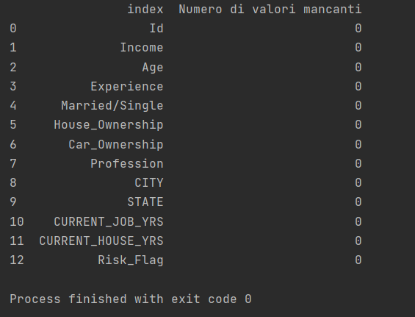
Data Cleaning
Missing Values
Checking for Missing Data: Use Pandas’ isnull() function to check for missing values and decide how to handle them (delete, replace, or impute). Using these function on our dataset, we have the following results:
Given this results, we can conclude that our dataset doesn’t contain any missing value. So we can proceed to correct duplicate values.
Duplicate Values
Checking for Duplicate Data: Use Pandas’ duplicated() function to check for duplicate data and decide how to handle them (delete or keep).
This results show that the dataset doesn’t contain duplicate data.

Slide 4
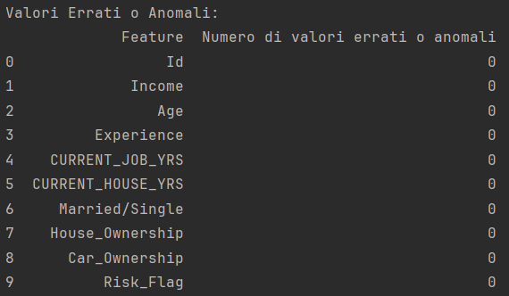
Data Cleaning
Wrong Values/ Outlier Values
Checking for Erroneous Data: Use Pandas’ value_counts() function to check for erroneous values and decide how to handle them (correct or delete).
This results show that all the numerical columns contain consistent data (no negative values) and all categorical columns with a small set of available values (like “Married/Single” or “House_Ownership”) don’t contain values outside of the available values.

Slide 5
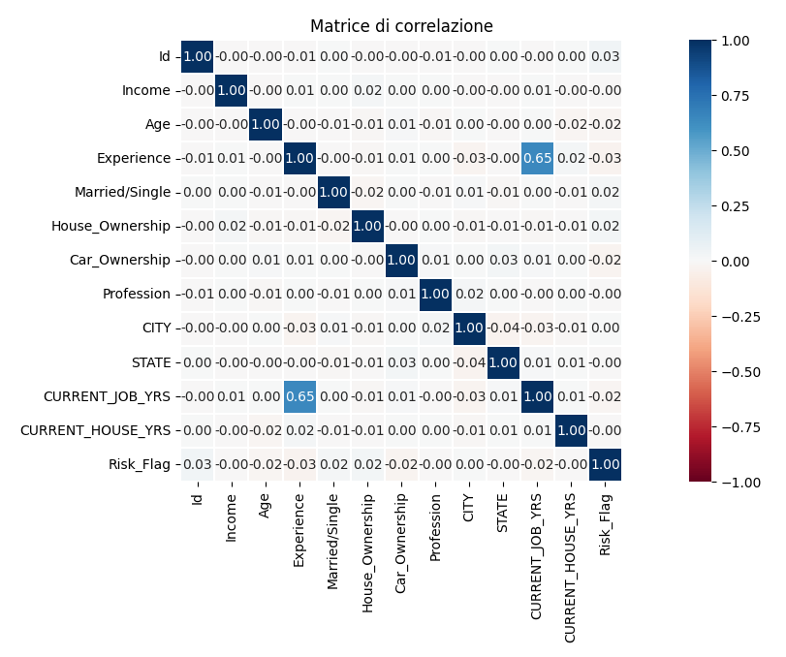
Data Exploration
Correlation Matrix: We created a correlation matrix to visualize these relationships. Interestingly, none of the features in our dataset showed significant correlation with the target variable. This suggests that our features are independent of each other, which is a good sign to avoid for certain types of models like linear regression and logistic regression. However, it also means that we may need to create interaction terms or use non-linear models to capture the relationships between features and the target variable.

Slide 6
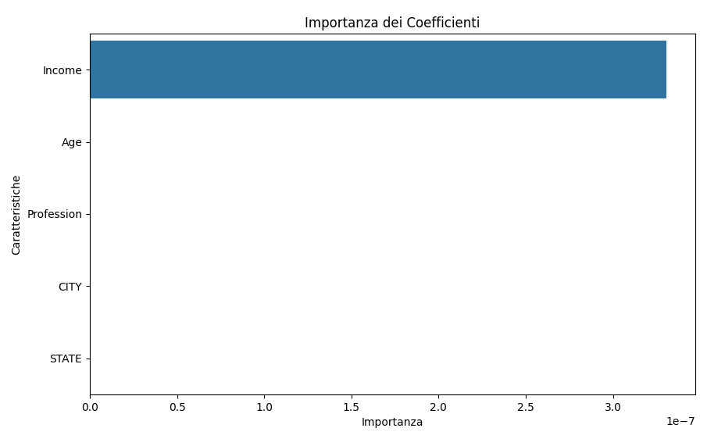
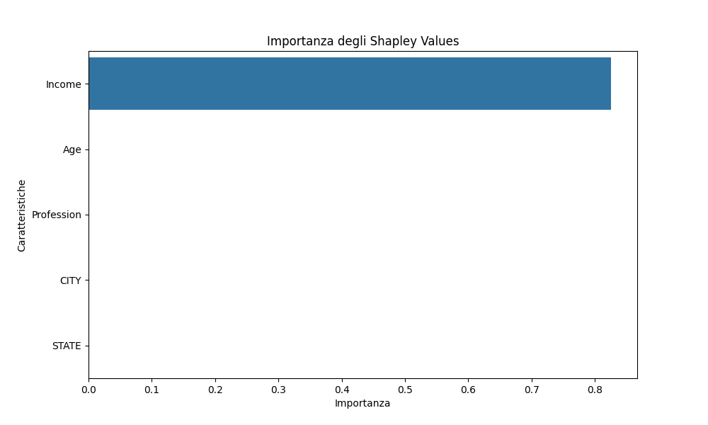
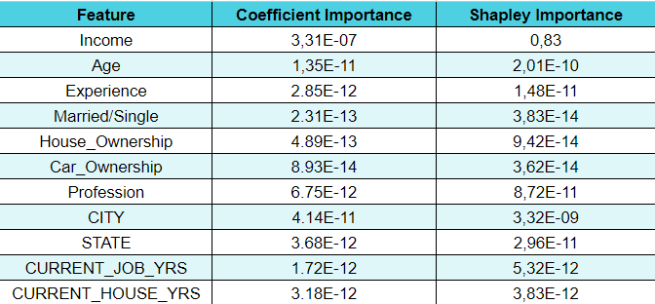
Data Exploration
Recursive Feature Elimination (RFE)
Linear Correlation Analysis (through Feature Importance and Shapley Values)
Given this results, we decided to keep all the features.
Also, we will need to use a non-linear model.

Slide 7
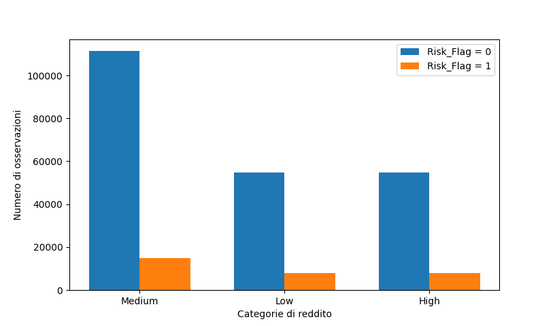
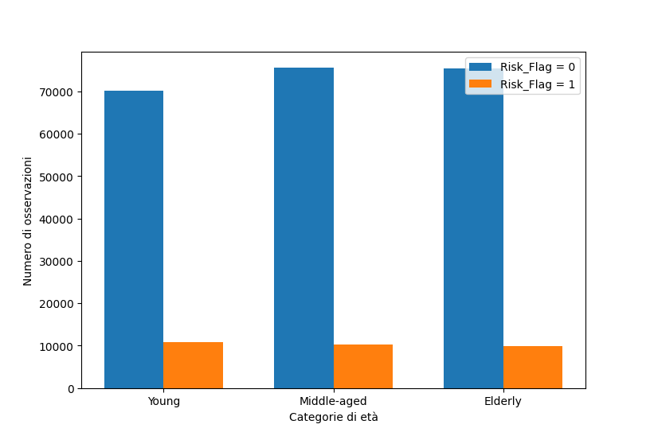
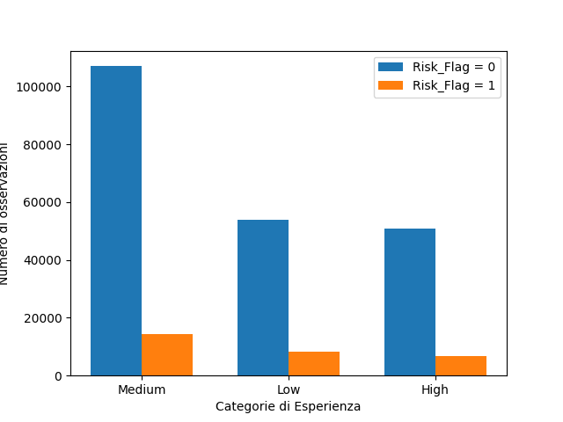
Data Exploration
Data Visualization
Exploratory Analysis of the Target Variable: We conducted an in-depth analysis of the target variable’s distribution. This involved understanding how the target variable relates to other features in the dataset. For example:
Income: As a continuous variable, we grouped it into categories (e.g. Low, Medium, High) to facilitate the visualization of its distribution.
Age and Experience: As integer variables with small ranges, we used overlaid histograms to visualize their distributions relative to the target variable.

Slide 8
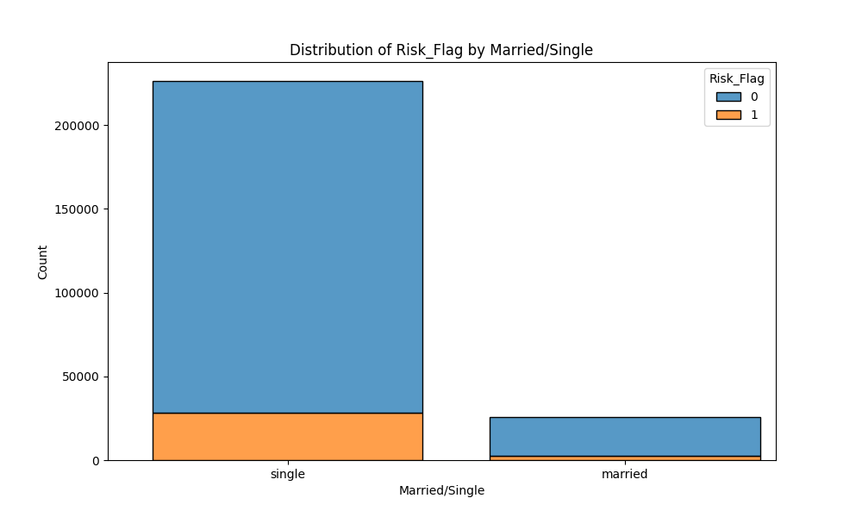
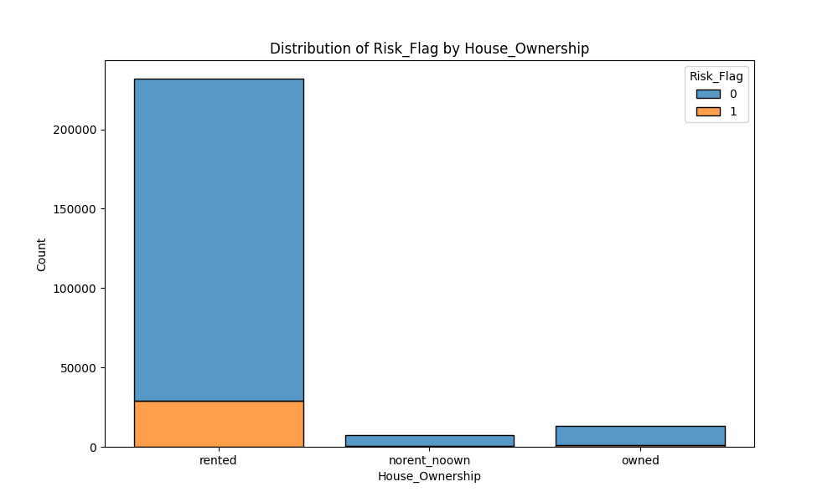
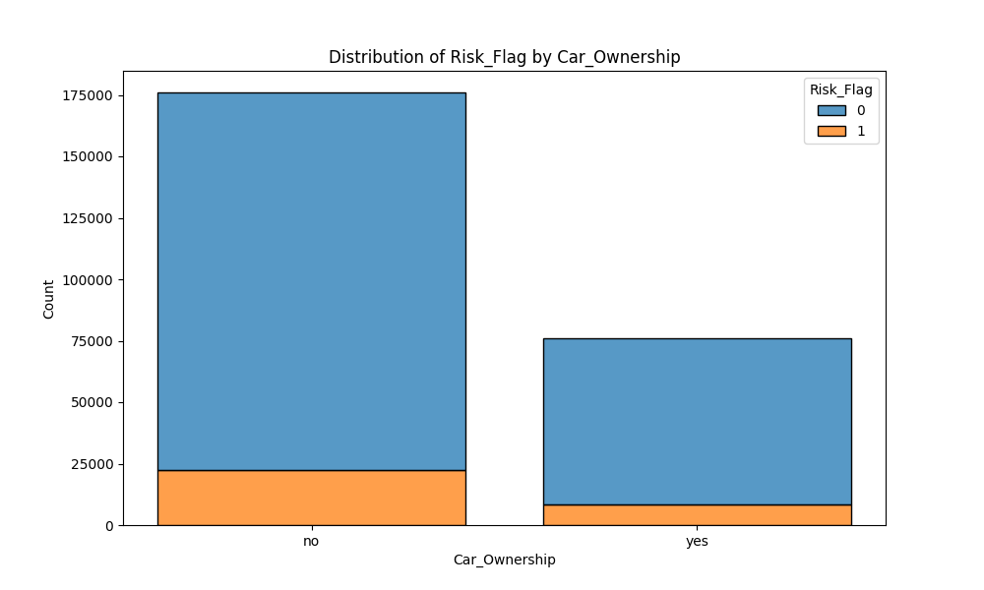
Data Exploration
Married/Single, House_Ownership, and Car_Ownership: As categorical variables with a small number of possible values, we used overlaid histograms to visualize the target variable’s distribution relative to these features.

Slide 9
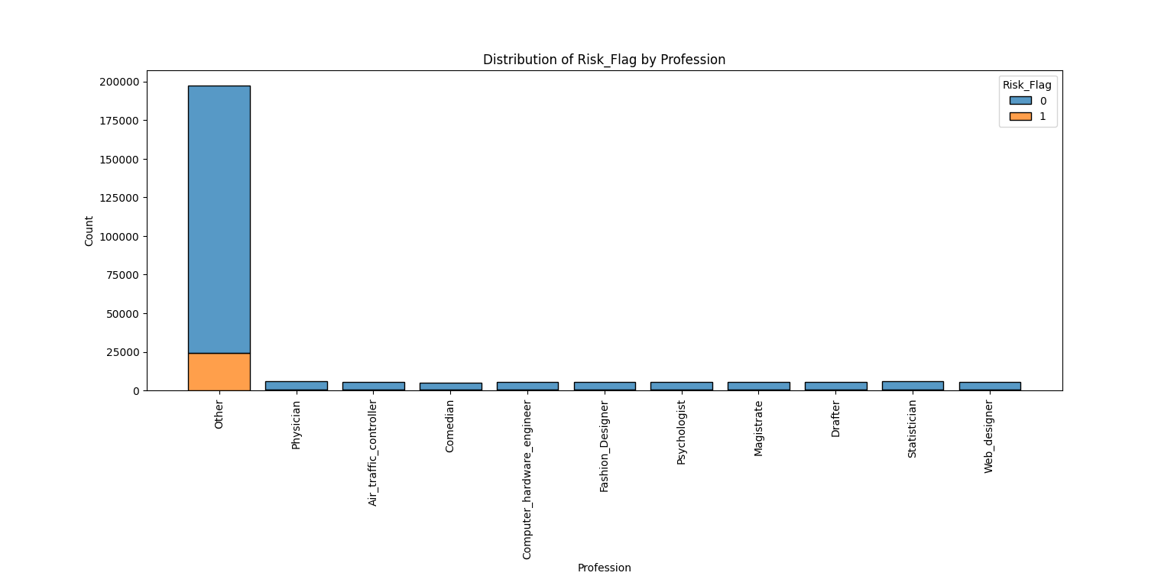
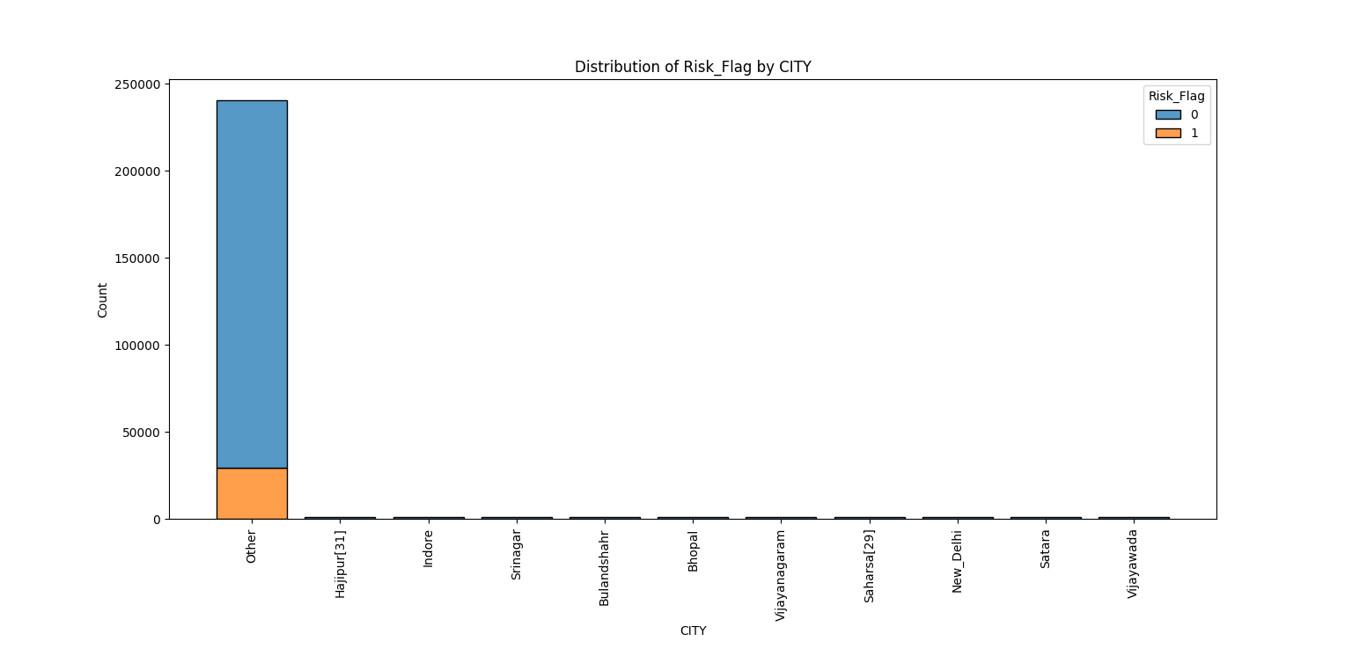
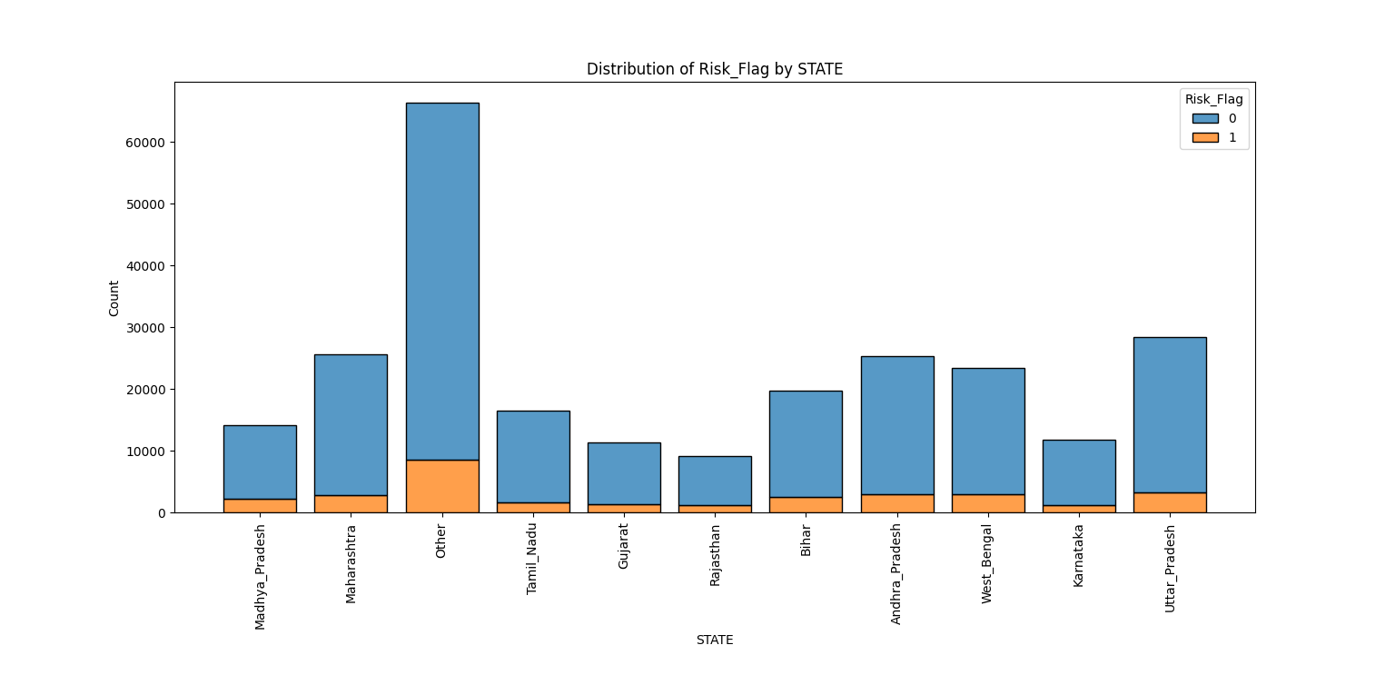
Data Exploration
Profession, CITY, and STATE: As categorical variables with a large number of possible values, we used frequency tables to visualize the target variable’s distribution relative to these features.

Slide 10
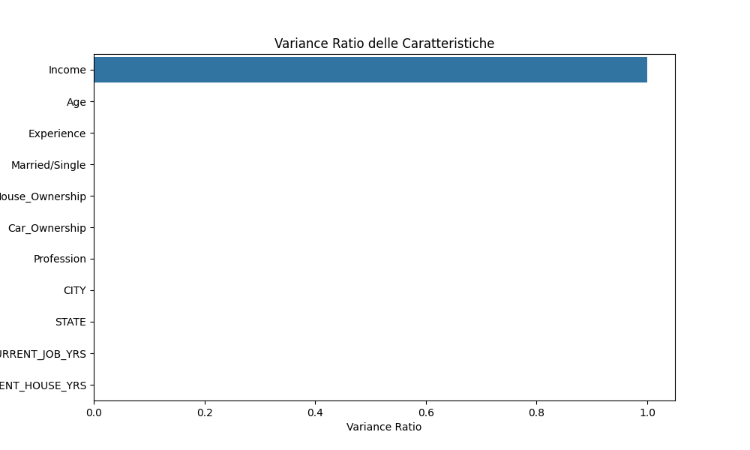
Feature Selection/Regularization
Principal Component Analysis (PCA)
We used PCA to reduce the dimensionality of our dataset and identify the most important features.
This graph shows that we can’t exclude any feature on a PCA basis, given the fact that all the features outside of “Income” have too low Variance Ratio to consistently evaluate which feature to eliminate.

Slide 11
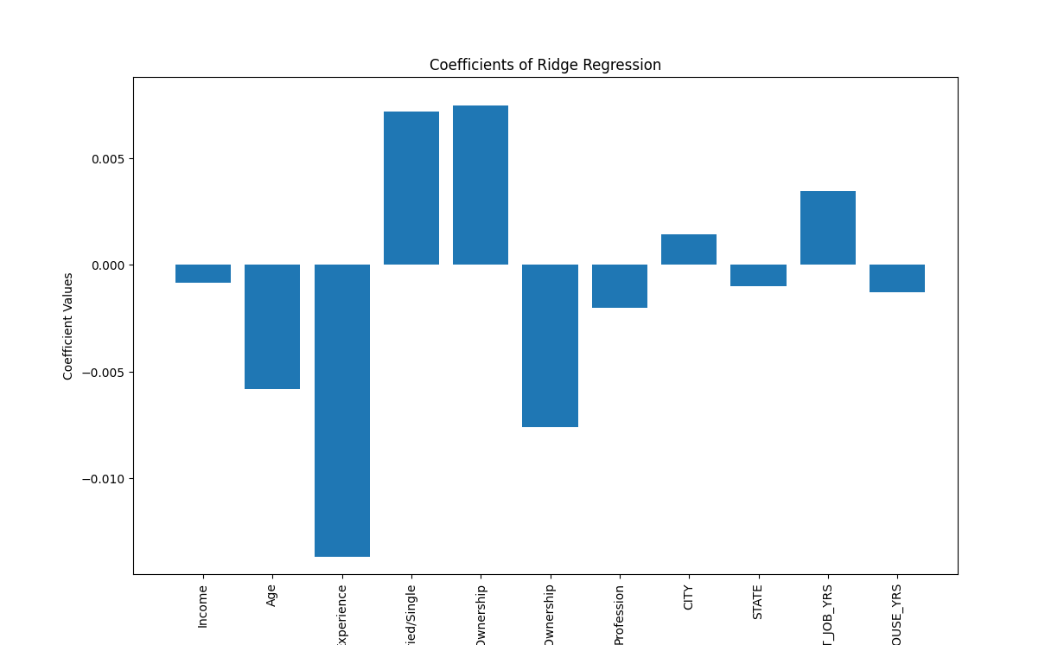
Feature Selection/Regularization
Regularization (L2-Norm)
L2-Norm Regularization (Ridge): We used Ridge regularization and varied the alpha value. The graph remains unchanged, indicating that the regularization effect is weak or negligible for this dataset or specific model. In other words, a Ridge regression model with these alpha values might behave similarly to a standard linear regression without regularization.

Slide 12
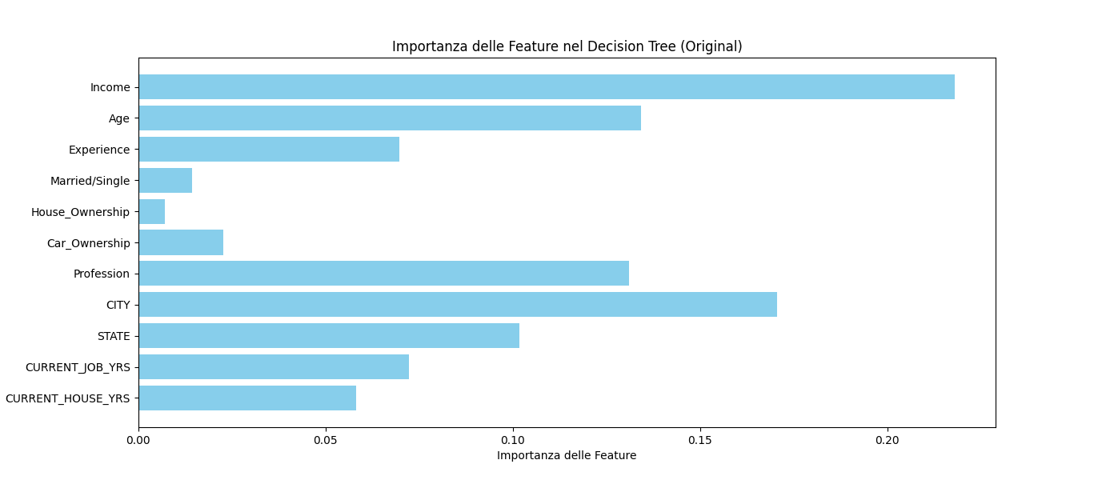
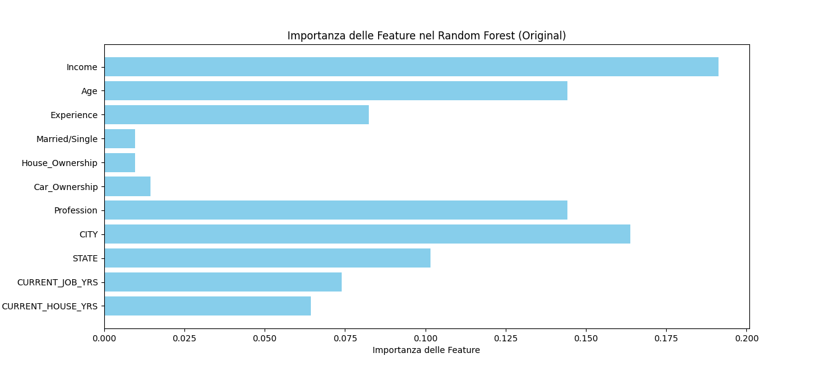
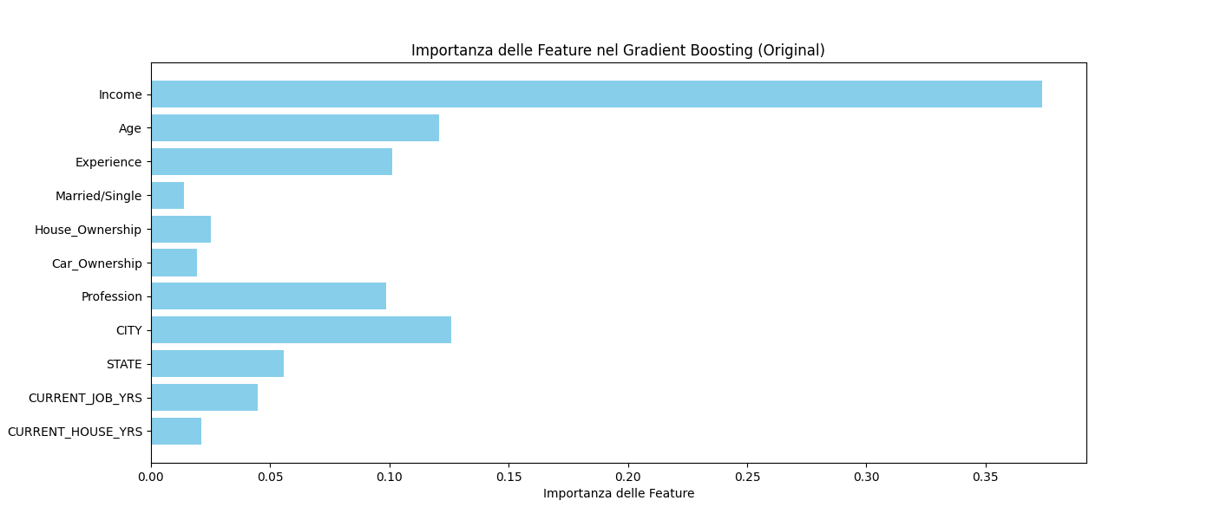
Feature Selection/Regularization
Feature importances with city and state

Slide 13
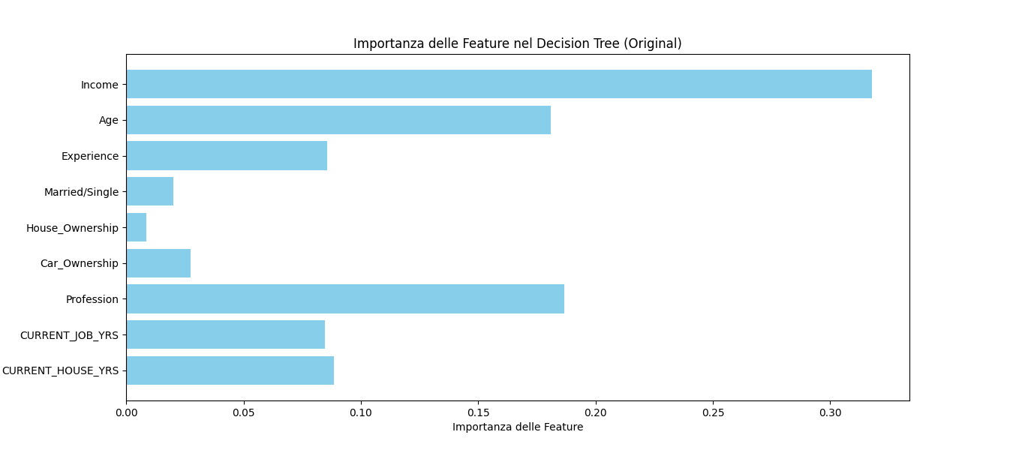
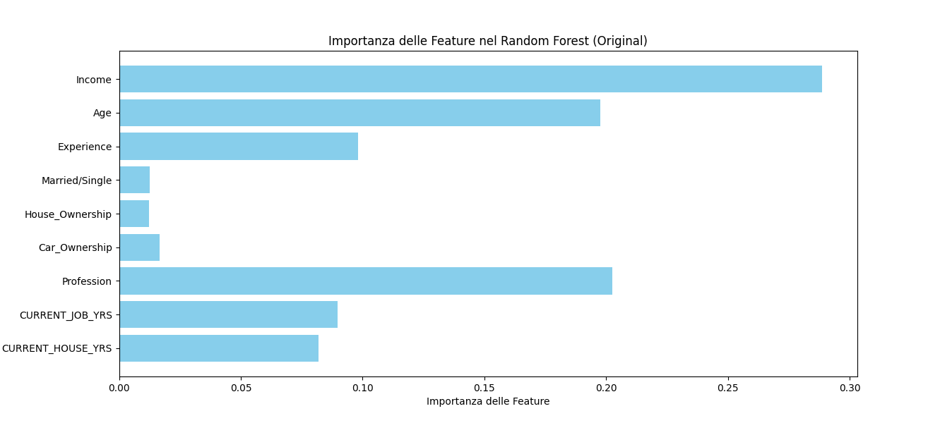
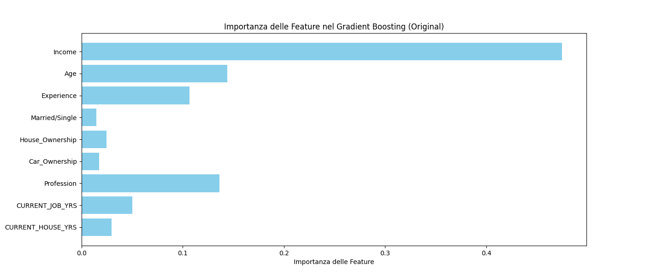
Feature Selection/Regularization
Feature importances without city and state

Slide 14
Applied Models
Decision Tree
Random Forest
Gradient Boosting
K-Nearest Neighbors (KNN)
MLPClassifier
NB: We used the same splitting for training set, validation set and test set for all the models
X_train, X_temp, y_train, y_temp = train_test_split(X_resampled, y_resampled, test_size=0.3, random_state=42)
X_val, X_test, y_val, y_test = train_test_split(X_temp, y_temp, test_size=0.5, random_state=42)
Also, we coded the categorical columns into numerical values to correctly apply classification models

Slide 15
Hyperparameter Tuning
Grid Search has been applied to all the models keeping the same configuration, to help results’ confrontation:
GridSearchCV(model, param_grid, cv=5, scoring='accuracy')
The best hyperparameters found from the Grid Search for the models are:
KNN:
{'n_neighbors': 9, 'p': 2, 'weights': 'uniform'}
Gradient Boosting:
{'learning_rate': 0.2, 'n_estimators': 150}
Decision Tree:
{'criterion': 'gini', 'max_depth': 20, 'min_samples_leaf': 4, 'min_samples_split': 10}
Random Forest:
{'bootstrap': False, 'max_depth': 20, 'min_samples_leaf': 4, 'min_samples_split': 10, 'n_estimators': 150}
MPL:
{'alpha': 0.01, 'hidden_layer_sizes': (128, 64, 32), 'activation': 'tanh', 'batch_size': 64, 'learning_rate': 'adaptive', 'solver': 'lbfgs'}}
NB:
We kept the parameter random_state=42 for all the models where the parameter was necessary.
The parameter max_iter for the MLP model was set to 200.

Slide 16
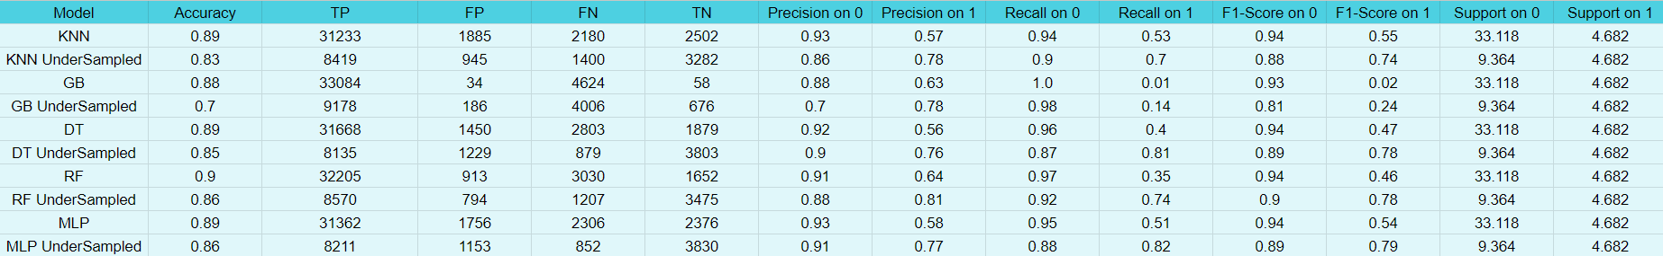
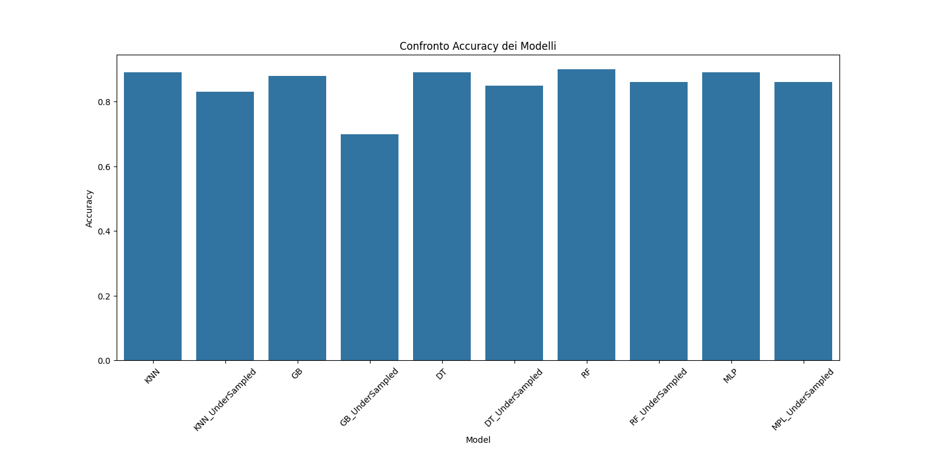
Results

Slide 17
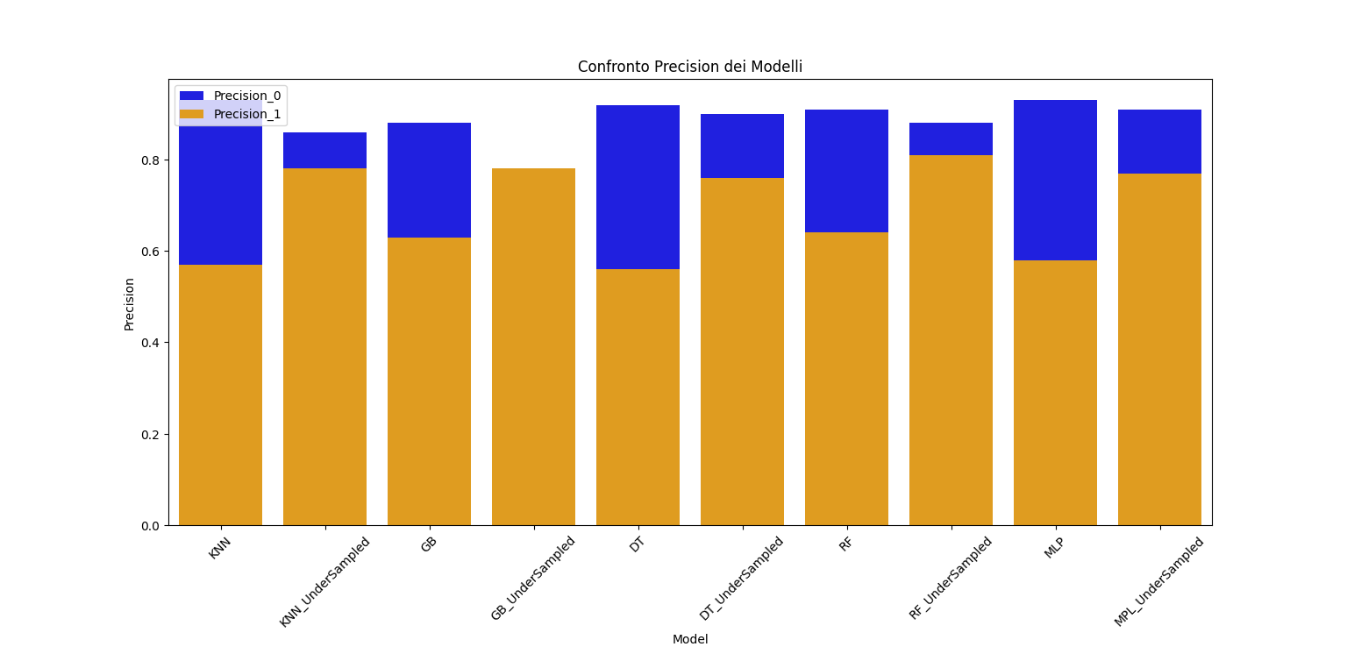
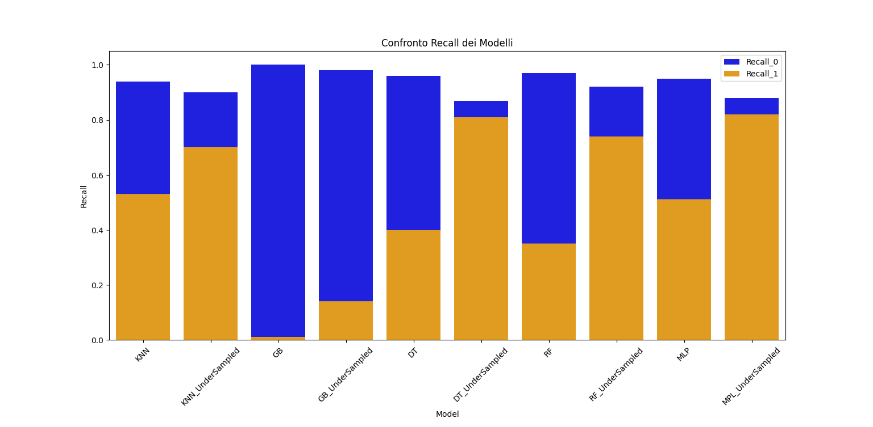
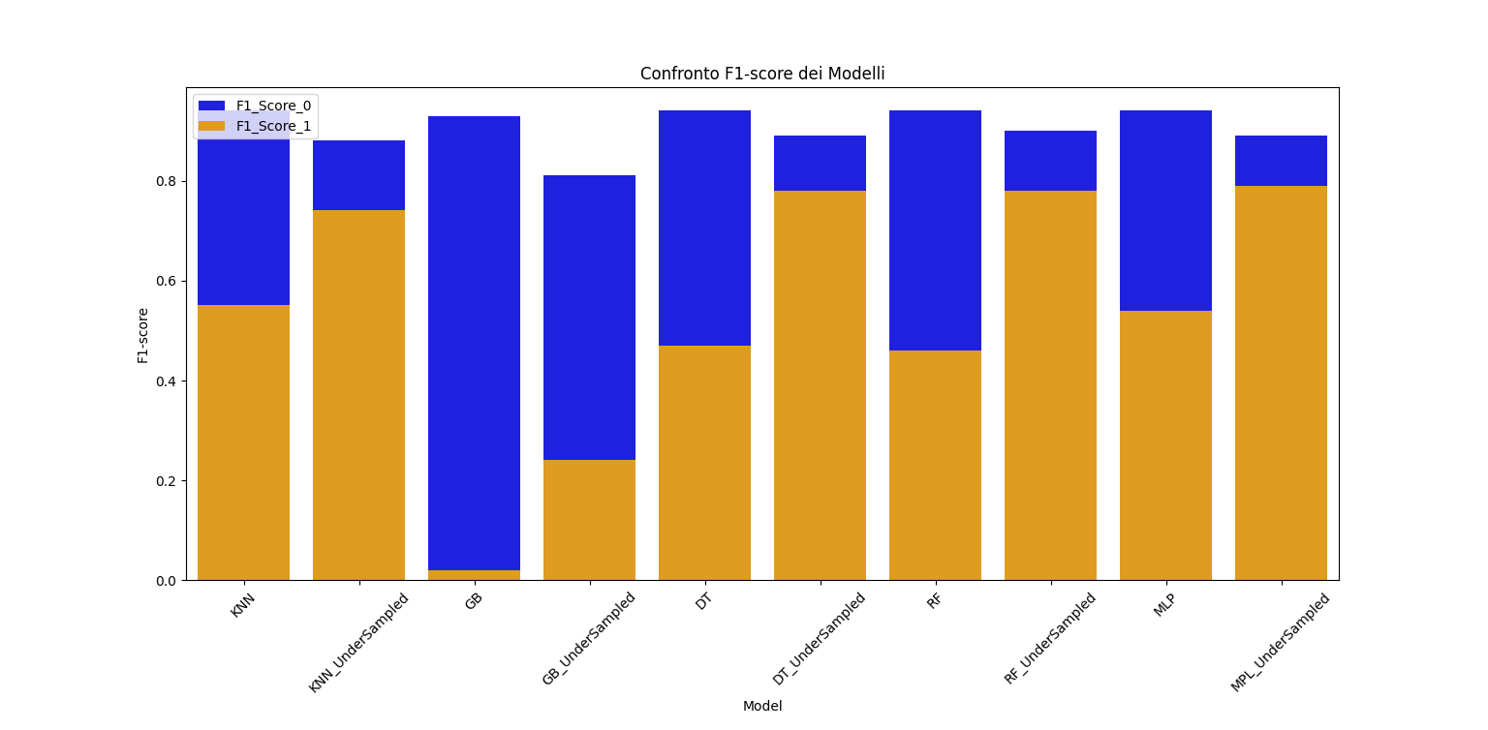
Results

Slide 18
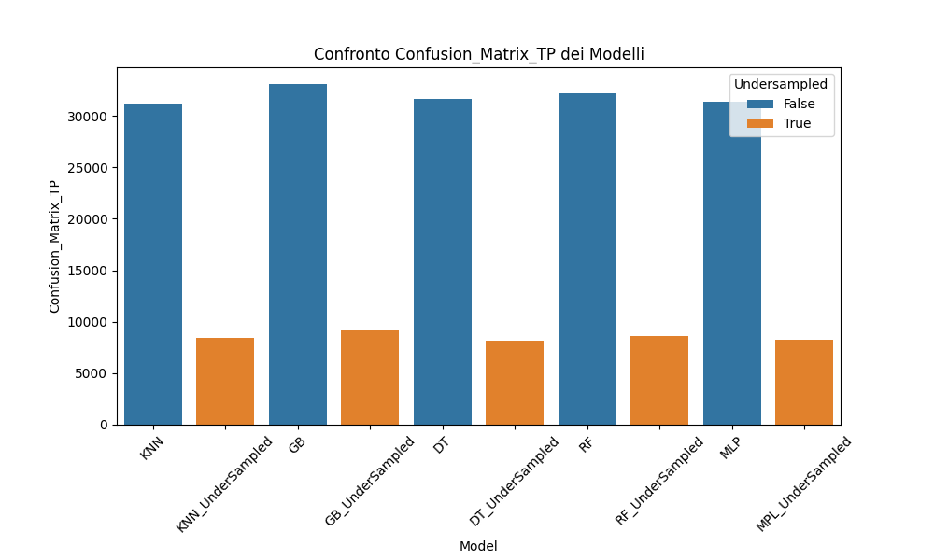
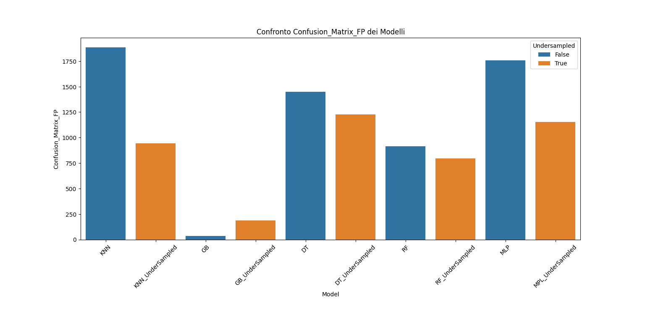
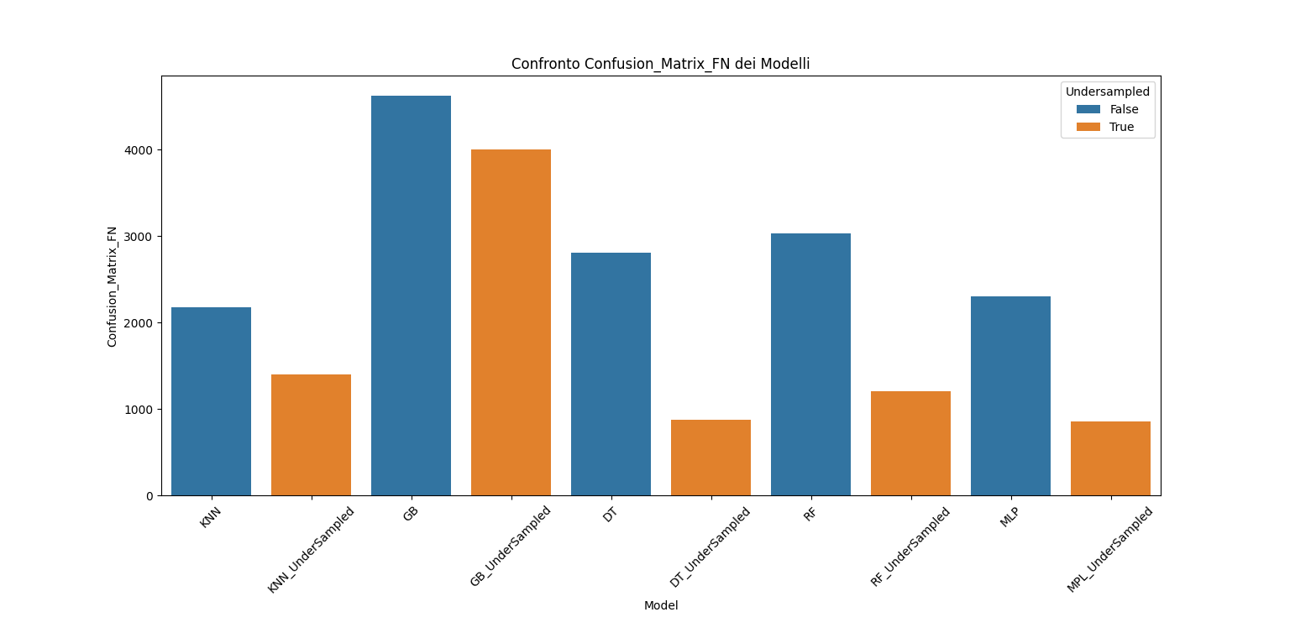
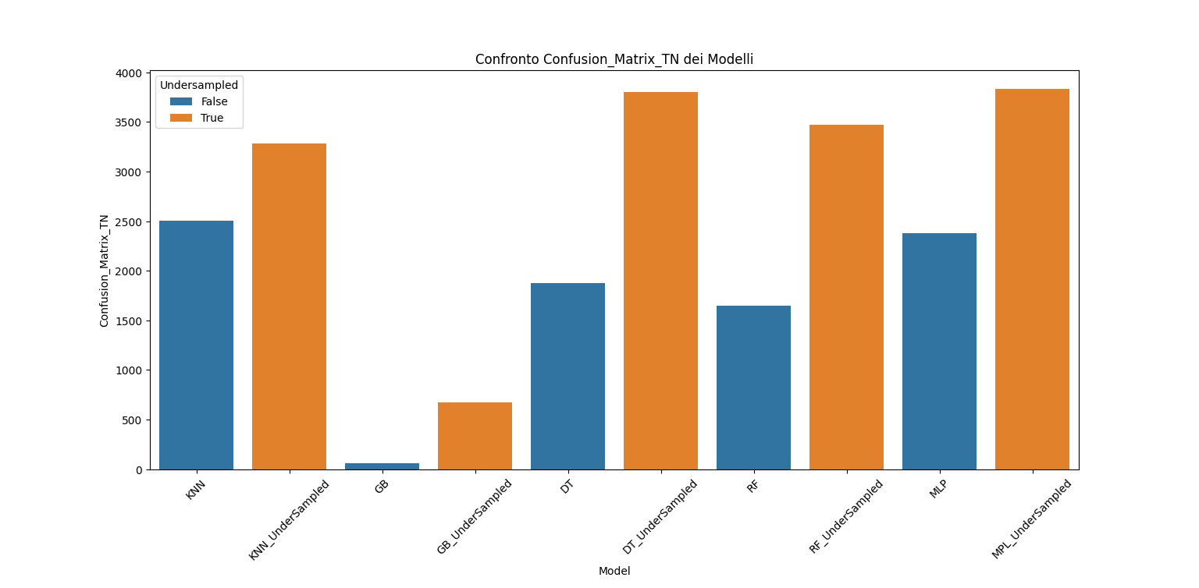
Results

Slide 19
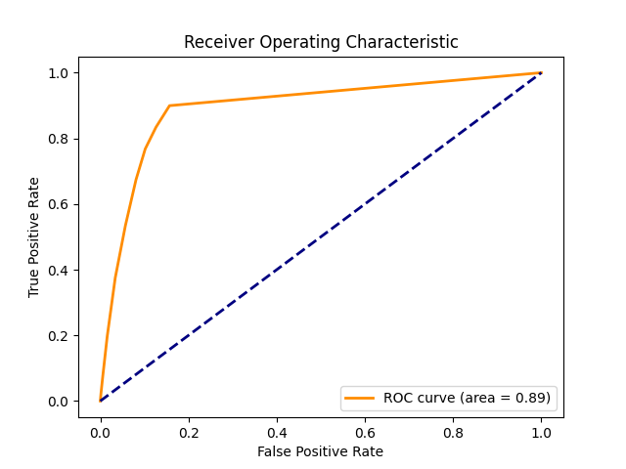
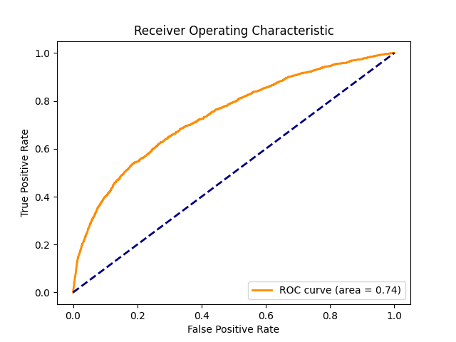
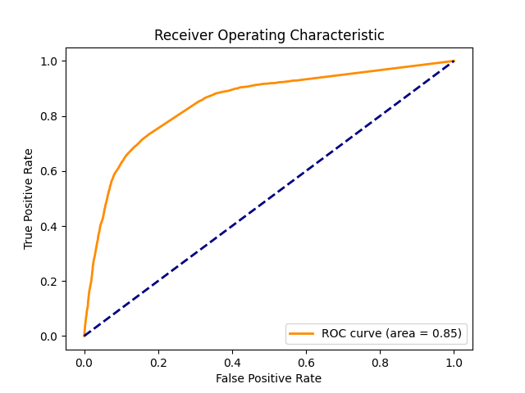
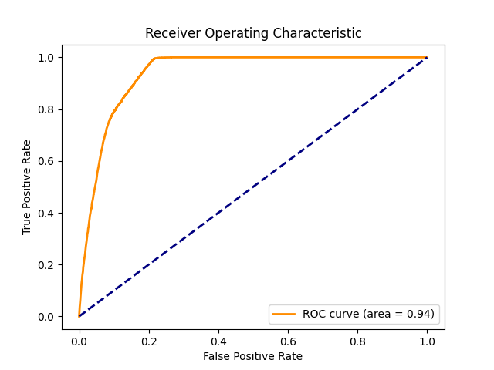
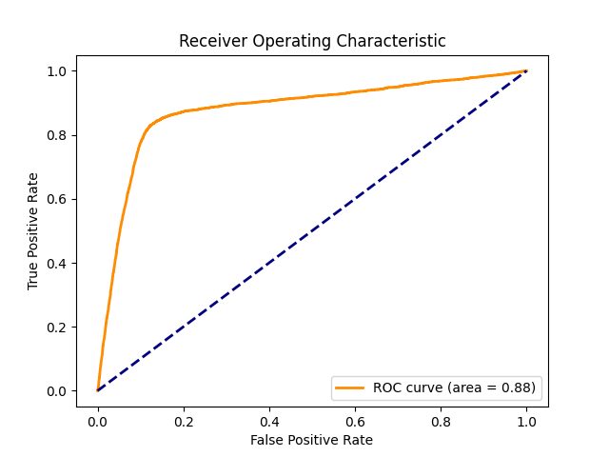
Results
KNN ROC Curve
Gradient Boosting ROC Curve
Decision Tree ROC Curve
Random Forest ROC Curve
MLP ROC Curve

Slide 20
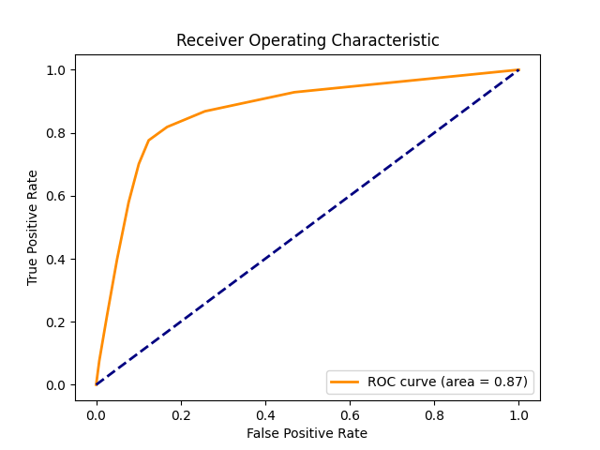




Results
KNN Undersampled ROC Curve
GB UnderSampled ROC Curve
DT UnderSampled ROC Curve
Random Forest UnderSampled ROC Curve
MLP UnderSampled ROC Curve

Slide 21
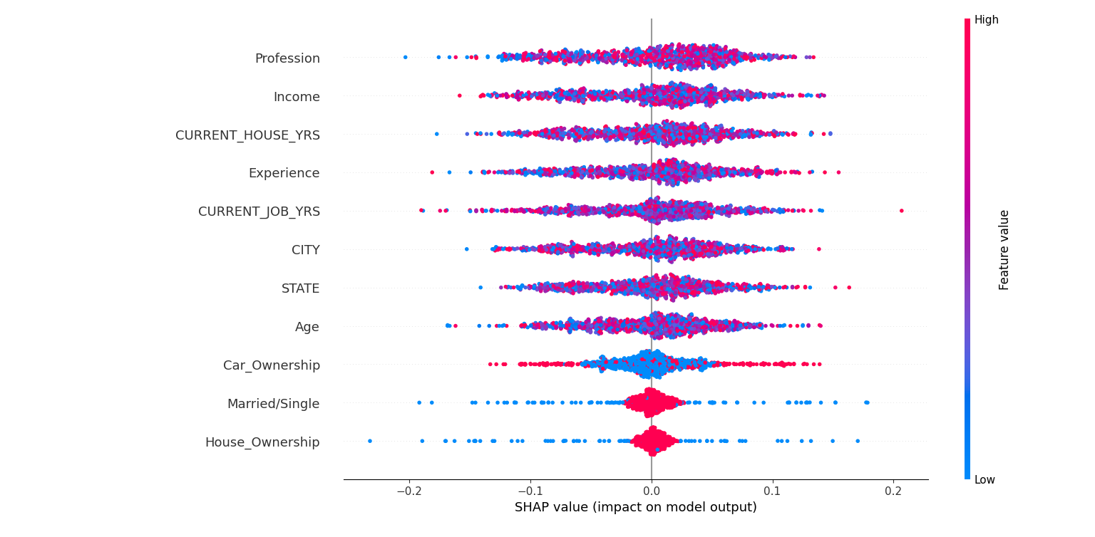
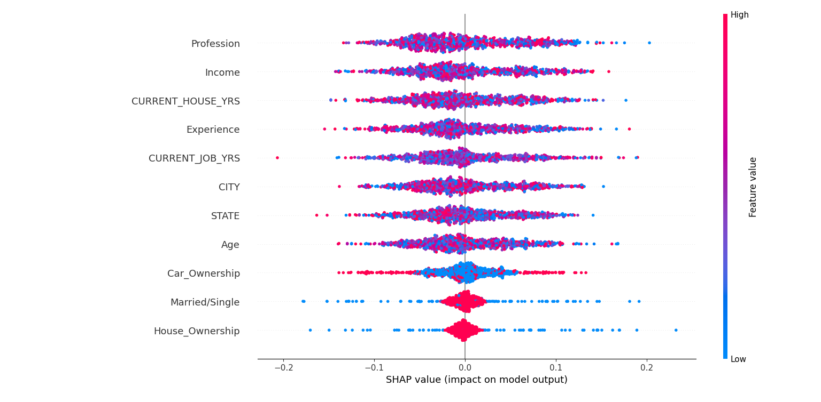
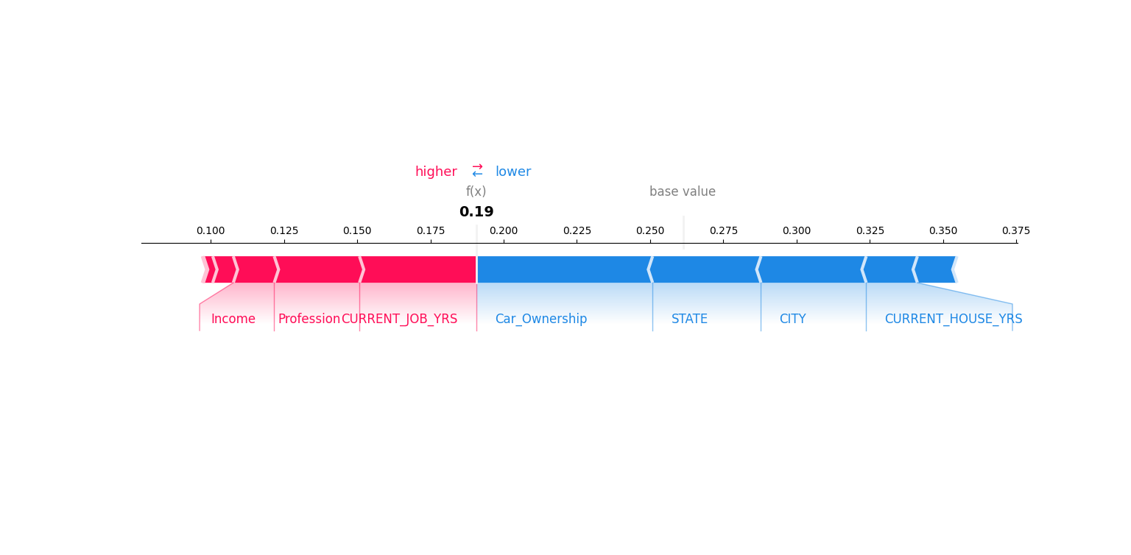
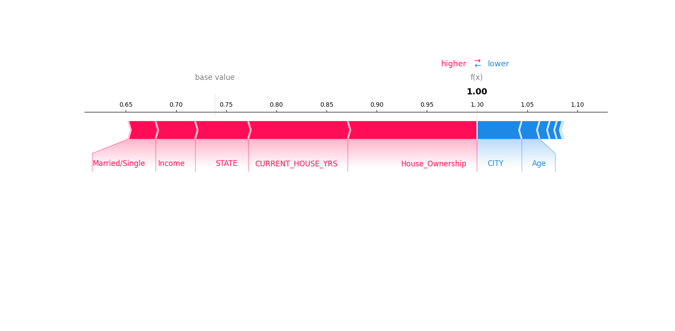
Data Explanation for Best Model (MLP)
SHAP Bee Plot for Class 0
SHAP Bee Plot for Class 1
SHAP Force Plot for a Class 0 Sample
SHAP Force Plot for a Class 1 Sample

Slide 22
Conclusions
From this results, we can conclude that:
KNN model shows a high accuracy, but there's room for improvement in recall for positive instances. The application of Undersampling improved recall, but precision for positive instances has decreased;
Gradient Boosting model low recall suggests the model struggles to identify positive instances. Undersampling improves recall, but decreases precision for positive instances;
Decision Tree model has balanced precision and recall, and it’s effective in identifying positive instances. The undersampling increases recall but lowers precision for positive instances;
Random Forest model enhances Decision Tree performances. Its Undersampled version has high recall and reasonable precision for positive instances;
MLP has balanced precision and recall and seems to have the best overall performance compared to the other models. Undersampling gives even better results.
Random Forest and MLP models demonstrate the best balance between precision and recall, but we chose MLP as Best Model for its higher Recall on class 1.

